Slide 1


Slide 2
LIMITATIONS
Years of data not consistent (some countries have 2 years of data, some countries have 8)
Pollution data not consistent (22 countries measured dissolved oxygen vs 18 measured water temp)
GDP and Population density data is static per country

Slide 3
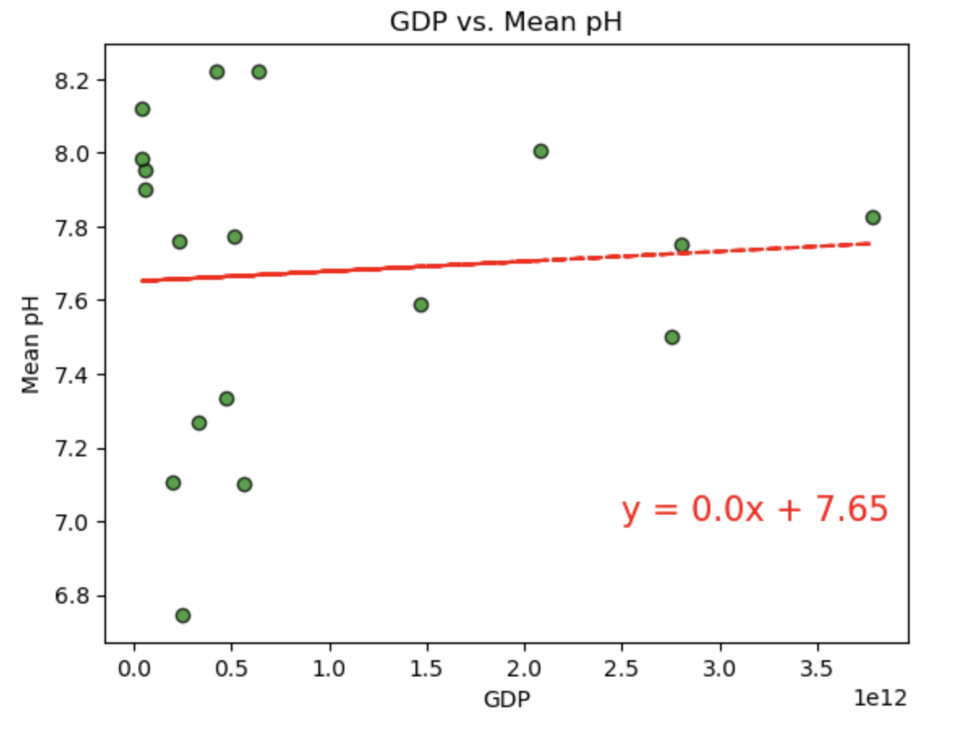
GDP vs. Pollution
01
02
03
pH
Dissolved Oxygen
Temperature

Slide 4
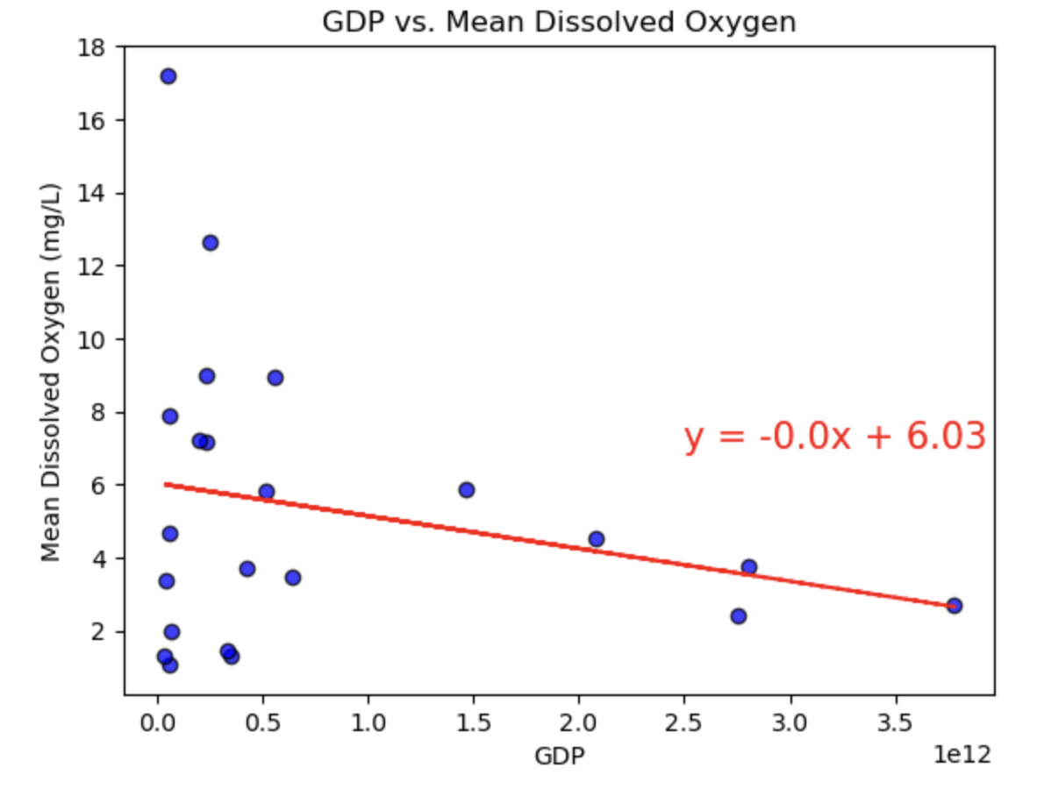
GDP vs. Pollution
01
02
03
pH
Dissolved Oxygen
Temperature

Slide 5
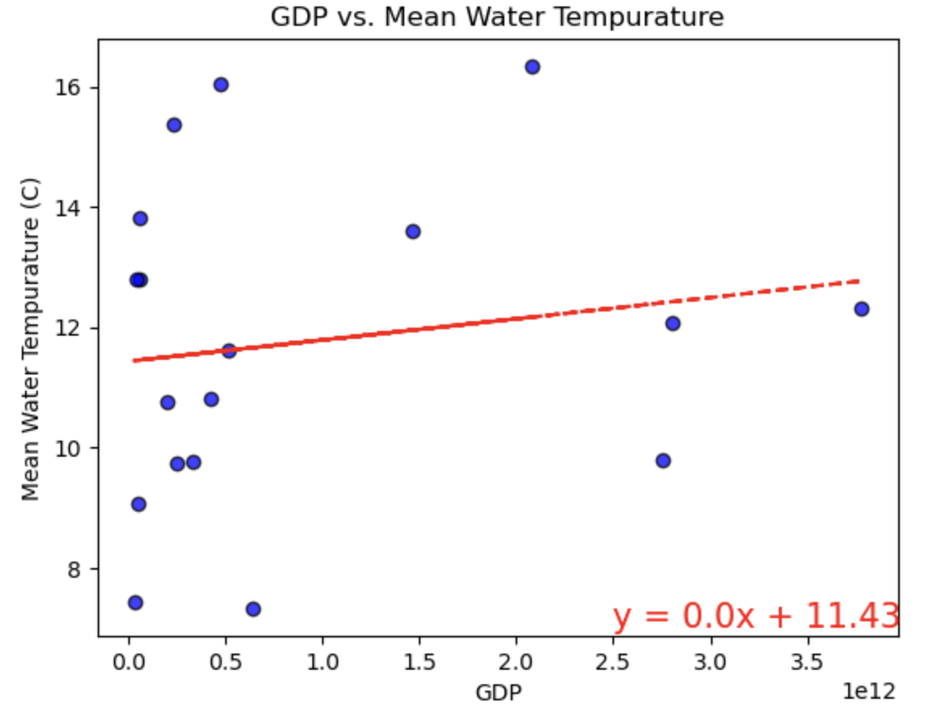
GDP vs. Pollution
01
02
03
pH
Dissolved Oxygen
Temperature

Slide 6
Population Density vs. Pollution
01
02
03
pH
Dissolved Oxygen
Temperature

Slide 7
Population Density vs. Pollution
01
02
03
pH
Dissolved Oxygen
Temperature

Slide 8
Population Density vs. Pollution
01
02
03
pH
Dissolved Oxygen
Temperature

